Slide 1

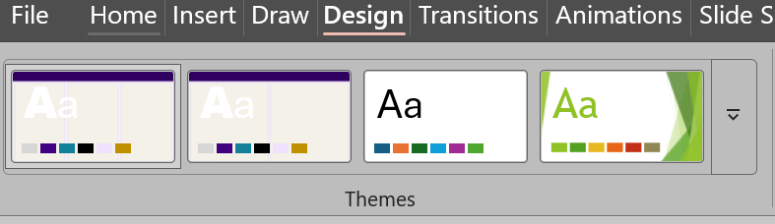
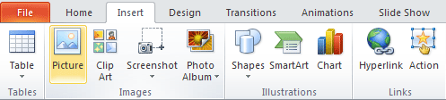



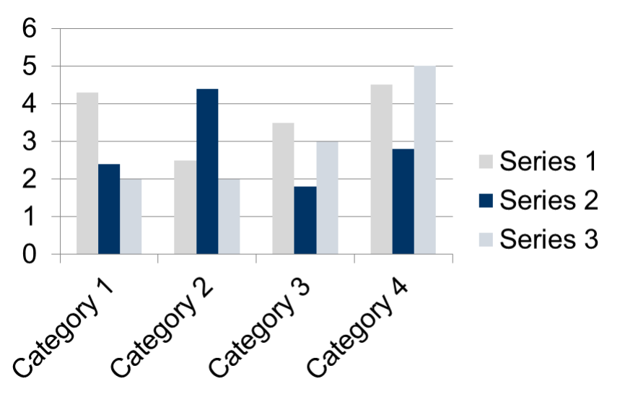
INSERT LOGO HERE
The poster title goes here
and here
Presenter1 Name¹; Co-Author Name² ¹Department, Institution, Country; ²Organization, Country
Introduction
Altering The Column Layout
Discussion
This template was designed to produce a 1189mm x 841mm (A0 size) poster in portrait orientation.
Making use of this template will ensure that your poster will look professional, easy to read and save you valuable time in the layout of your presentation.
For poster design beginners we have included many useful tips you can find on the poster template itself.
The goal of the Introduction is to provide the "hook" and the "why". Start by defining the broader problem and narrowing down to your specific research gap.
Background: Briefly summarize current knowledge to set the stage.
The Gap: Clearly identify what is currently unknown or problematic in the field.Objectives:
Explicitly state your hypothesis or the specific goals of the study. Keep text concise; this section should guide the reader quickly into your methodology.
Depending on your content and how you wish to layout your poster, you may want to change the column layout of your poster to 2 columns. To select a different layout go to the DESIGN tab (Figure 5). Then you can easily select the second alternate column layout from the 2 options available.
For further column size customization, click the tab View > Slide Master
The Discussion Section may be combined with Results as in a Results and Discussion Section.
The Discussion serves as the intellectual heart of your poster, where you interpret your findings and bridge the gap between data and discovery. While the Results show your evidence , the Discussion explains its significance and addresses the "so what?" of your research.
Here are the essential components for a concise Discussion:
Interpret Your Findings:
Explain what your results mean in relation to your original hypothesis.
Compare to Prior Work: Note if your data supports or contradicts existing literature.
Address Limitations: Be transparent about any study constraints or potential sources of error.
Highlight Significance: State the broader implications and real-world applications of your work.
Propose Future Research: Suggest the next logical steps to advance this line of inquiry.
Figure 5
Text Sizes
For this poster template the Arial font family is used at several recommended text sizes. You can use any typeface you like and at any size but try to stay close to the suggested limits. Figure 4 gives a visual reference of what different font sizes look like when printed at 100% and at 200%. Due to a page size limitation in PowerPoint and unless your poster is going to be less than 56” in length, all the work done on this template is at half the size of the final poster. For example, if you choose a 21 point font for this poster, the actual printed size will appear as 42 points.
Materials and Methods
Conclusion
This section must provide enough detail for a peer to understand your process without overwhelming a casual reader.
Experimental Design: Use a narrative flow to describe your setup, but consider a bulleted list for specific equipment or software versions.
Procedures: If the process is complex, a small flowchart or diagram is often more effective than a wall of text.
Statistical Analysis: Mention the tests used (e.g., ANOVA, T-tests) and the software (e.g., SPSS, R) to validate your results.
Core Content to Include
Experimental Design: Define the overall setup of your study, including any control groups or specific variables tested.
Materials and Equipment: List essential materials, chemical concentrations, or specific software versions used; use bullet points to save space.
Protocol Flow: Briefly outline the chronological steps of your procedure; consider a small flowchart to replace dense paragraphs.
Sampling/Subjects: Detail your sample size, selection criteria, or population demographics to establish the scope of your results.
Statistical Methods: Explicitly state the statistical tests used to analyze the data (e.g., t-test, ANOVA) and the threshold for significance.
The conclusion should not just restate the results; it should interpret them.
Summary: Provide a clear answer to the research question posed in the introduction.
Implications: Discuss why these findings matter for the field or for practical applications.
Future Work: Briefly mention the next steps or unanswered questions to invite discussion during the poster session.
Importing Photographs
It is highly recommended to use the largest images you have access to for your poster. Avoid images downloaded from the web and avoid copying and pasting images instead of using the “Insert” command. To insert an image to your poster go to the INSERT tab and then click on PICTURE (Figure 8).
(Figure 8)
When the only source of a needed photo or graphic is the Web, scaling must be applied with caution. Scaling an image more than three times its original size may introduce pixilation artifacts. Refer to Figure 9 as an example. A simple way to preview the printing quality of an image is to zoom in at 100% or 200%, depending on the final size of the poster. What you’ll see is likely what you’ll get at printing time.
References
Author, A. (Year). Article Title. Journal Name, Vol(Iss), pp-pp.
Author, B. (Year). Book Title. Publisher.
Author, C. (Year). Conference Paper Title. Proceedings, pp-pp.
Results
This is the most critical part of your poster and should occupy the most visual space.
Visuals Over Text: Rely on high-resolution charts and graphs imported directly from Excel or Word.
When scaling these, always hold the Shift key to prevent distortion.
Narrative Support: Each figure should have a brief, descriptive caption. In the main text body, don't just repeat the numbers from the graphs; describe the trends or significant differences observed.Image
Quality: Avoid "copy-pasting" low-resolution images from the web.
Essential Elements for the Results
Data Visuals: Prioritize charts, graphs, and tables over dense text to improve readability.
Key Trends: Use brief narrative text to highlight significant patterns or findings.
Statistical Evidence: Include necessary labels and units to validate your findings.
Comparative Analysis: Group data logically to show relationships between different categories.
Standalone Captions: Ensure every figure is identifiable via section headers or clear labels.
Results and Discussion may be combined as one section.
Acknowledgements
Acknowledge funding sources or support staff (optional).
Figure 9: Original image at 100%, enlarged 200% and 400%.
Importing Tables and Graphs
Importing tables, charts and graphs is easier than importing photos. To import charts and graphs from Excel, Word or other applications, select EDIT>COPY, to copy your chart and then come back to PowerPoint. From PowerPoint, select EDIT>PASTE and paste the chart on the poster. You can scale your charts and tables proportionally by holding down the Shift key and dragging in or out one of the corners.
Contact Information
Table 1. Distribution of Abstracts by Thematic Area (ICWES20)
Corresponding author’s Name
Address | Tel: +1 066 - 666666 Fax: +1 066 - 777777 Email: author@address.org Web: www.yourwebsite.org

